Slide 1
Introducing the Task Parallel Library

Slide 2

No need to try to remember all the slides or the code
Except this slide ☺
http://github.com/srstrong/DDDSW2010

Slide 3
Fill out your Eval forms
There’s swag later..

Slide 4
Topics
Why care about concurrency?
What’s wrong with what we’ve got?
TPL – Raising the abstraction
Data parallelism
Task parallelism
Asynchronous Patterns
PLinq
Other .Net 4 concurrency features

Slide 5
Why Concurrency?

Slide 6
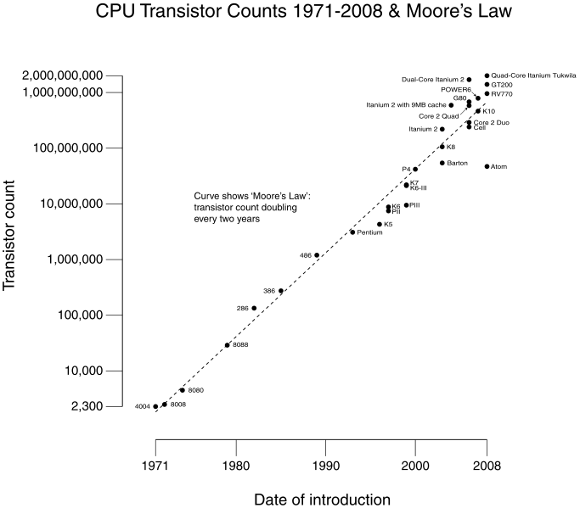

Slide 7


Slide 8
Concurrency is hard
Reasoning about sequential code is easy
Shared, mutable state is the norm
Moving to concurrent code means:
Reasoning about the possible execution paths becomes very hard
Need for locks etc to protect share state and to synchronise execution
Data races / deadlocks are difficult to reproduce and debug
Need for global understanding

Slide 9
Task Parallel Library
New in .Net 4.0
Doesn’t “solve” concurrency
But does provide some new tools
Higher level of abstraction

Slide 10
Parallel.For()
Concurrent version of sequential for loop
12 overloads providing variety of options
Basic (and most common) is simply:
Initial value
Max value
Delegate
Demo

Slide 11
Parallel.ForEach()
Concurrent version of sequential foreach loop
20(!) overloads
Basic (and most common) is simply:
IEnumerable<T>
Delegate
Demo

Slide 12
.For() & .ForEach()
System partitions input into sets
Each thread given sets of work to process
Thread iterates over set calling lambda
If thread exhausts set, can “steal” from other threads

Slide 13
What about all those overloads?
Not as bad as it looks
5 key concepts
ParallelLoopState
Iteration Index
Local thread data
ParallelOptions
Partioner & OrderablePartioner
Overloads are just combinations of these

Slide 14
ParallelLoopState
Additional parameter that allows the loop to be monitored & manipulated
IsStopped, IsExceptional, ShouldExit, Break(), Stop()
Demo also shows ParallelLoopResult & Index
public static ParallelLoopResult ForEach<TSource>(
IEnumerable<TSource> source,
Action<TSource, ParallelLoopState> body
)

Slide 15
Iteration Index
Provides each iteration with a loop index
Saw this in the ParallelLoopState demo
public static ParallelLoopResult ForEach<TSource>(
IEnumerable<TSource> source,
Action<TSource, ParallelLoopState, long> body
)

Slide 16
LocalThreadState (TLocal)
Provides each thread with local data accessible from all iterations performed on that thread
public static ParallelLoopResult ForEach<TSource, TLocal>(
IEnumerable<TSource> source,
Func<TLocal> localInit,
Func<TSource, ParallelLoopState, TLocal, TLocal> body,
Action<TLocal> localFinally
)

Slide 17
Parallel Options
Provides access to execution options:
Degree of parallelism
Task Scheduler
Cancellation Token
public static ParallelLoopResult ForEach<TSource>(
IEnumerable<TSource> source,
ParallelOptions parallelOptions,
Action<TSource> body
)

Slide 18
Task Schedulers
Default is based on the Thread Pool
Work stealing, thread injection & retirement
Can write your own custom implementation
May be able to perform better if your data has very specific characteristics
But the default does perform well in most scenarios

Slide 19
Partitioners
Responsible for splitting source data into multiple sets
As with Schedulers, the defaults work well
can still use custom if required
Demo
public static ParallelLoopResult ForEach<TSource>(
Partitioner<TSource> source,
Action<TSource> body
)

Slide 20
Exception Handling
Exceptions from iterations are gathered
When all iterations complete, a single AggregateException is throw
Within the AggregateException, the original exception(s) can be accessed
No indication as to which iteration(s) threw
If this matters to you, you need to pass it out in the exception
Demo

Slide 21
Cancellation
Already seen .Break & .Stop from within loop
Can also cancel from outside…
Demo

Slide 22
Cancellation Notes
CancellationSource is used to create tokens
From the source, can “cancel” any of the tokens
Workers can monitor tokens to determine if they should exit
Tokens can be combined
So if worker has many cancellation tokens, only needs to check the combo
Cancellation can trigger method call (such as an async cancel)
CancellationToken.Register()
Token has WaitHandle available, so worker can wait on it efficiently

Slide 23
Tasks
The Parallel.For() and Parallel.ForEach() methods are great for data parallelism
The Task class forms the basis for, you guessed it, Task parallelism
And, incidentally, is what is used internally by Parallel.*

Slide 24
Basic Task Functionality
Creating and starting
Return values
Accessing local variables
Waiting
Cancelling
Exception handling
Including handling unhandled exceptions
Demo

Slide 25
Continuations
This is where Tasks get funky
Allows the chaining of tasks
Easy to use, very powerful
Demo

Slide 26
Continuation Options
Allows you to decide when a continuation is run
Many options, such as:
OnRanToCompletion, OnFaulted, OnCancelled
NotOnRanToCompletion, NotOnFaulted, NoOnCancelled
ExecuteSynchronously, LongRunning

Slide 27
Nested Tasks
Tasks may create other tasks
By default, there is no strong relationship between them
But can specify that tasks are created as children, which changes behaviour
Watch out for exceptions…
Demo

Slide 28
Async support in Tasks
Tasks can support for asynchronous operations
Web calls, File IO etc.
.FromAsync()
Demo
A basic async example
And a complex one
Which we may skip if time is tight

Slide 29
PLinq
Linq (to Objects)
But Parallel
And easy
Demo

Slide 30
PLinq Notes
Query is parallelised if useful
Plinq examines query to decide
Various options
WithExecutionMode, WithDegreeOfParallelism,
WithCancellation, WithMergeOptions
AsParallel, AsSequential, AsOrdered, AsUnordered
Exception handling, cancellation etc you already know
See, all that previous stuff was worthwhile ☺

Slide 31
Misc
Running tasks on the UI Thread
Demo. Shows Continuations, Parallel.For & UI thread operations
Thanks to MSDN ☺
Concurrency Visualizer
Useful reports from the VS2010 profiler

Slide 32
And Other Stuff
System.Collections.Concurrent
ConcurrentDictionary, ConcurrentStack, ConcurrentQueue, ConcurrentBag, BlockingCollection
System.Threading
Barrier, CountdownEvent, ManualResetEventSlim, SemaphoreSlim, SpinLock, SpinWait, ThreadLocal<T>, LazyInitializer
System.Lazy<T>

Slide 33
Remember
Always measure; do not assume parallel is faster
Avoid shared memory
Avoid too much parallelism
Avoid non-thread-safe methods
Limit calls to “thread safe” methods
They may be locking, and hence killing your concurrency
Don’t assume parallelism => potential for deadlock
One iteration should never wait on the completion of another iteration

Slide 34
References
Slides and Source on Github
http://github.com/srstrong/DDDSW2010
MSDN Parallel Computing Site
http://msdn.microsoft.com/en-us/concurrency/default.aspx
.Net Parallel Programming
http://msdn.microsoft.com/en-us/library/dd460693(VS.100).aspx
MSDN Parallel Programming Blog
http://blogs.msdn.com/b/pfxteam/
Task Parallel Library
http://msdn.microsoft.com/en-us/library/dd460717.aspx
Extensive Samples
http://code.msdn.microsoft.com/Project/Download/FileDownload.aspx?ProjectName=ParExtSamples&DownloadId=10226
Concurrency Visualizer
http://msdn.microsoft.com/en-us/library/dd537632.aspx

Slide 35
Again, fill out your Eval forms
There’s swag later..

